Slide 1
Final Presentation
William Bouchard - Software Lead
Yanis Jallouli - Testing Lead
Andy Li - Documentation Manager
Trevor Tabah - Software Engineer
Ben Weiss - Project Manager
Yazdan Zinati - Hardware Lead

Slide 2
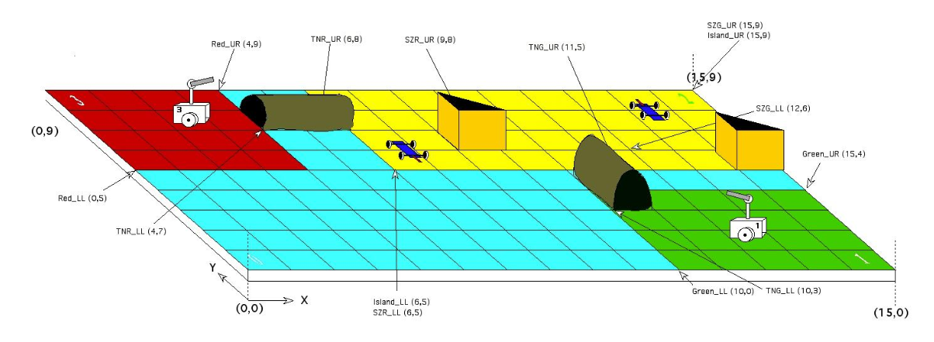
Design To Date
Initial Localization
  Code ✔
  Tested ✔ (informally)
Navigation to Island
  Code ✔
  Tested ✔ (informally)
Trailer Searching
  Code 50%
  Tested ✘
Rescue
  Code ✘
  Mech Design ✔
  Tested ✘
Notes:
ANDY → 30 seconds
TREVOR → 30 seconds

Slide 3
Foreseeable Problems
Claw Reliability
Threading
Navigation with the trailer
Calibrate colour Identification
Obstacle avoidance
Unpredictability of other robot
Notes:
TREVOR → 1.25 min
The claw has not been tested with the trailer behind it so it is possible it does not hold during the navigation back to the starting point
Threading: during our research and development phase, we had 6 threads running at one time and it posed no problems. I know that the code for our robot now, has a maximum of 6 threads running at one time. However, we have been told that the EV3 block has a hard time handling that many so there is a possibility this causes issues later.
Navigation with Trailer: For the navigation with a trailer, our navigation is not implemented to take into account

Slide 4
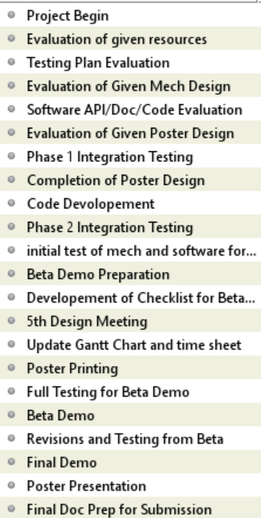
Future Gantt
Milestones: Project Begins → 5th/1st Design Meeting → Beta Demo → Final Demo
Resource allocation has been estimated and was totaled in the next slide
Evaluation of given resource includes rewrite of capabilities document by PM
Distribution based off secondary roles can cause shifts
  Ex. Don’t know which other member would have competency in software to help the software lead in programming
Tasks to be completed before a future team can complete the project
Notes:
BEN → 1 min

Slide 5
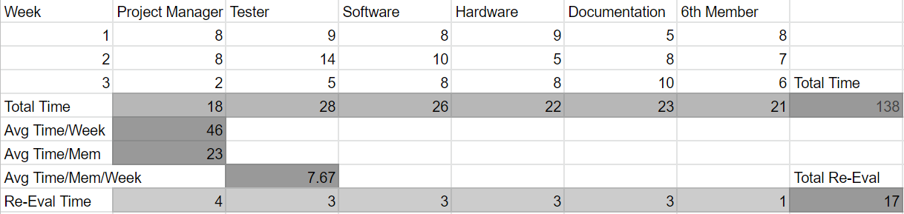
Future Budget
Chose 3 weeks to complete; 2 weeks would have been too much work and 4 would have been too little
Re-Eval time represents time the future team will need to spend understanding what we have done already (also included in Total Time)
  If they decide to make changes to what we have done, this time and total time would increase
Notes:
BEN → 1min 30

Slide 6
Existing Project - Gantt/Budget
111 hours spent so far (Weeks 1 and 4 were actually about 3 days)
Other: Brainstorming, meetings, idea evaluation, etc.
Testing low because testing docs were made but most testing not yet done
Category | Time spent (hrs) | Percent of total
Software | 19.5 | 17.6%
Hardware | 14.5 | 13.1%
Testing | 6 | 5.4%
Management | 13 | 11.7%
Documentation | 42 | 37.8%
Other | 16 | 14.4%
Notes:
Ben -> 1 min

Slide 7
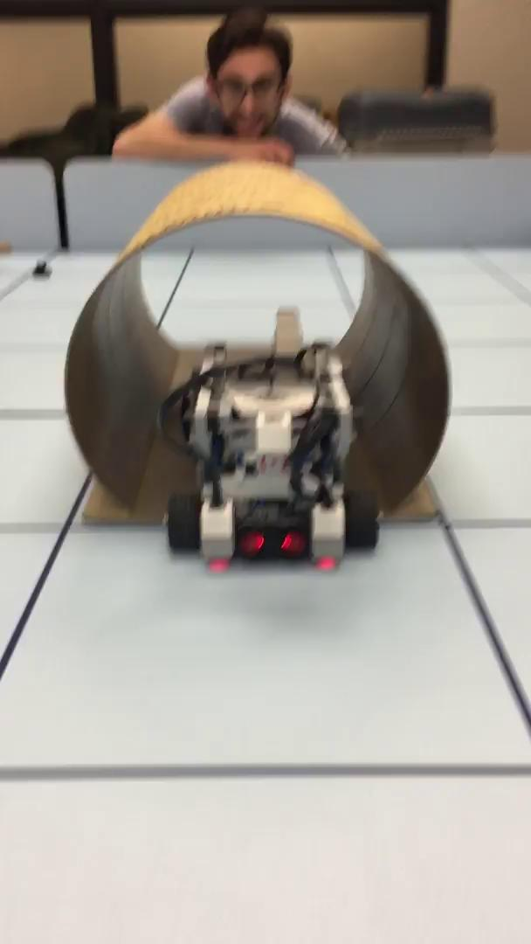
Software (Completions)
Complete Software Flow in Main
Initial Localization
Navigation to Tunnel
Crossing Tunnel
Light Localization Tunnel Adjustments
Game Parameters Setting
Notes:
WILL → 1 min 30

Slide 8
Software (TODO List)
Hook
  Pin detection on the trailer
  Deploying the hook (claws)
Light Localization
  Adjust the position when searching
Navigation
  Detection of obstacles
  Differentiation between Wall, tunnel, trailer or obstacle
-- TODOs were left in the code --
Notes:
WILL → 1 min

Slide 9
Test Plan
Equipment Characterization Completed
Full procedures available for all tests, basic test of first phase completed
Finish Unit tests
  Ultrasonic localization, Line Detection, Color Detection, Odometry, Turning, Locate Trailer, Grab Trailer
Complete Integration tests
  Travel To, Light Navigation Correction, Obstacle Avoidance, Find+Grab Trailer, Move with Trailer
Run Black Box System Test
  Recreate final demo as best as possible
detailed testing plan–the tests should be listed, full descriptions provided along with the expected outcomes of the tests that would allow the test to be labelled as a “success”
Notes:
YANIS → 1 minute
Actual (so far): 0:47.15

Slide 10
Unit Tests
Odometry
  Description: Travel in square, recording measured vs. true offsets
  Success: <1 cm error Euclidean distance per meter traveled, <5 degrees angle error
Turning
  Description: Turn from various angles to various angles
  Success: Minimum turn angle, <3 degrees error
Locate Trailer
  Description: Find trailer in various board locations
  Success: Stops and correctly identify obstacle
Grab Trailer
  Description: Move from various positions to grab trailer
  Success: Successful grab every run
Ultrasonic Orientation
  Description: Orient robot from various angles
  Success: <5 degrees error from positive y
Ultrasonic Localization
  Description: Localize from various positions in tile
  Success: <3 cm error Euclidean distance
Line Detection
  Description: Cross lines in many lightings
  Success: Correct identification in every case
Color Detection
  Description: Read color in many lightings with sensor various offsets from perfectly over
  Success: Identify color in every case but half off
Notes:
YANIS → 30 seconds
Actual: 0:56.76
Explain one of them with full description and success scenarios, explain doing all will take to long, and move one, saying they can review the slides or test documents on their own if curious.

Slide 11
Integration Tests
Travel To
  Description: Run through waypoints
  Success: <3 cm Euclidean distance error
Light Navigation
  Description: Navigate waypoints with light sensors
  Success: <1 cm Euclidean distance error
Obstacle Avoidance
  Description: Run search algorithms with obstacles in various locations/angles
  Success: Avoid hitting obstacles with relatively close (judged by eye) turns in every case
Find & Grab Trailer
  Description: Search board for the trailer in various locations and latch onto it (no obstacles)
  Success: Robot successfully grabs cart in every scenario
Move With Trailer
  Description: Navigate through waypoints with trailer (including through a tunnel)
  Success: <3 cm Euclidean distance error and does not hit tunnel walls
Notes:
YANIS → 30 seconds
Actual: 0:45.6

Slide 12
Black Box System Test
Description: A full run of the entire project as close as possible to the final demonstration scenario.
Success: The trailer is successfully retrieved and brought back to the home island without the robot hitting obstacles or ‘falling’ into the river
Notes:
YANIS → 30 seconds
Actual: 0:28.89

Slide 13
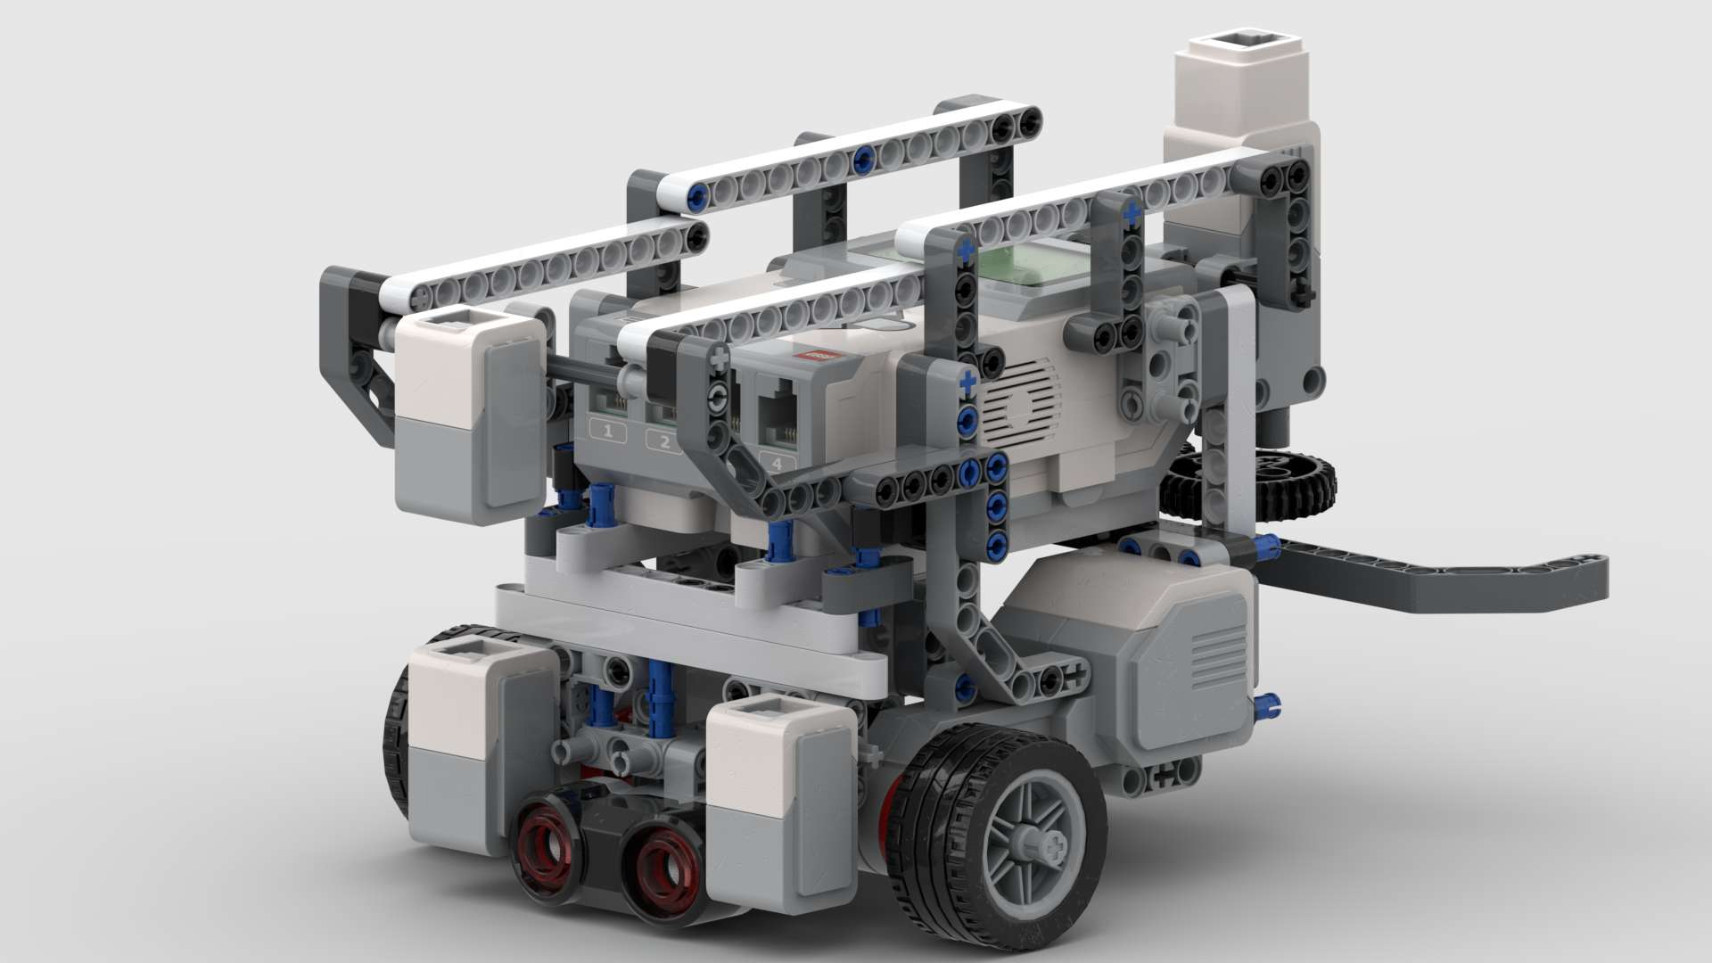
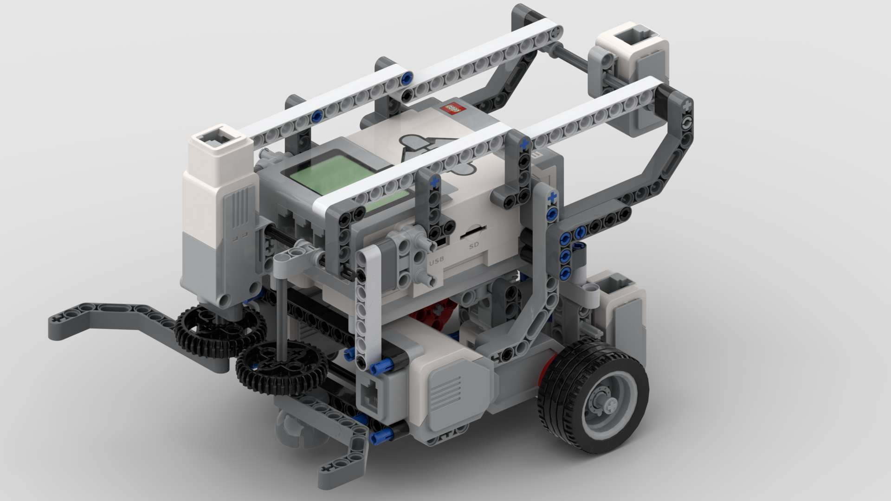
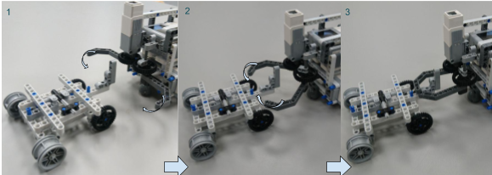
Hardware State
Objectives met
  Localization
  Navigation
  Search and Rescue
  Obstacle detection (partially)
Notes:
Yazdan -> 2 min

Slide 14
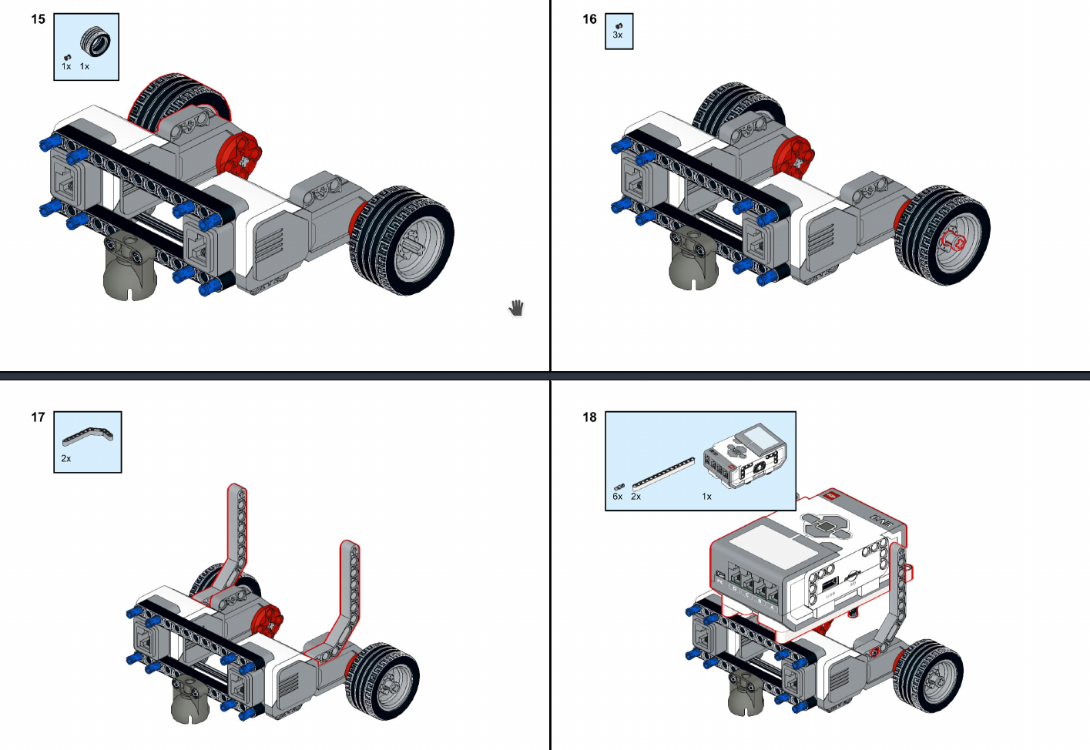
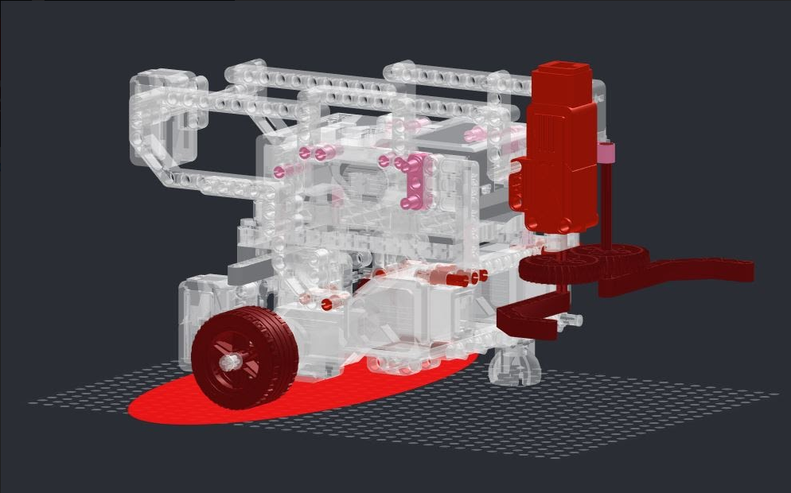
Hardware TODO
Available resources for the future team
  Detailed guide on resuming the hardware design
  Design Files (LXF, LDR)
  Building instructions PDF
  Instructions on opening designs and building guides
  Robot stability tests
TODO
  Improve the stability of the pickup claw
  Making the easily battery accessible and swappable
  Minor adjustments to be done based on future test results

Slide 15
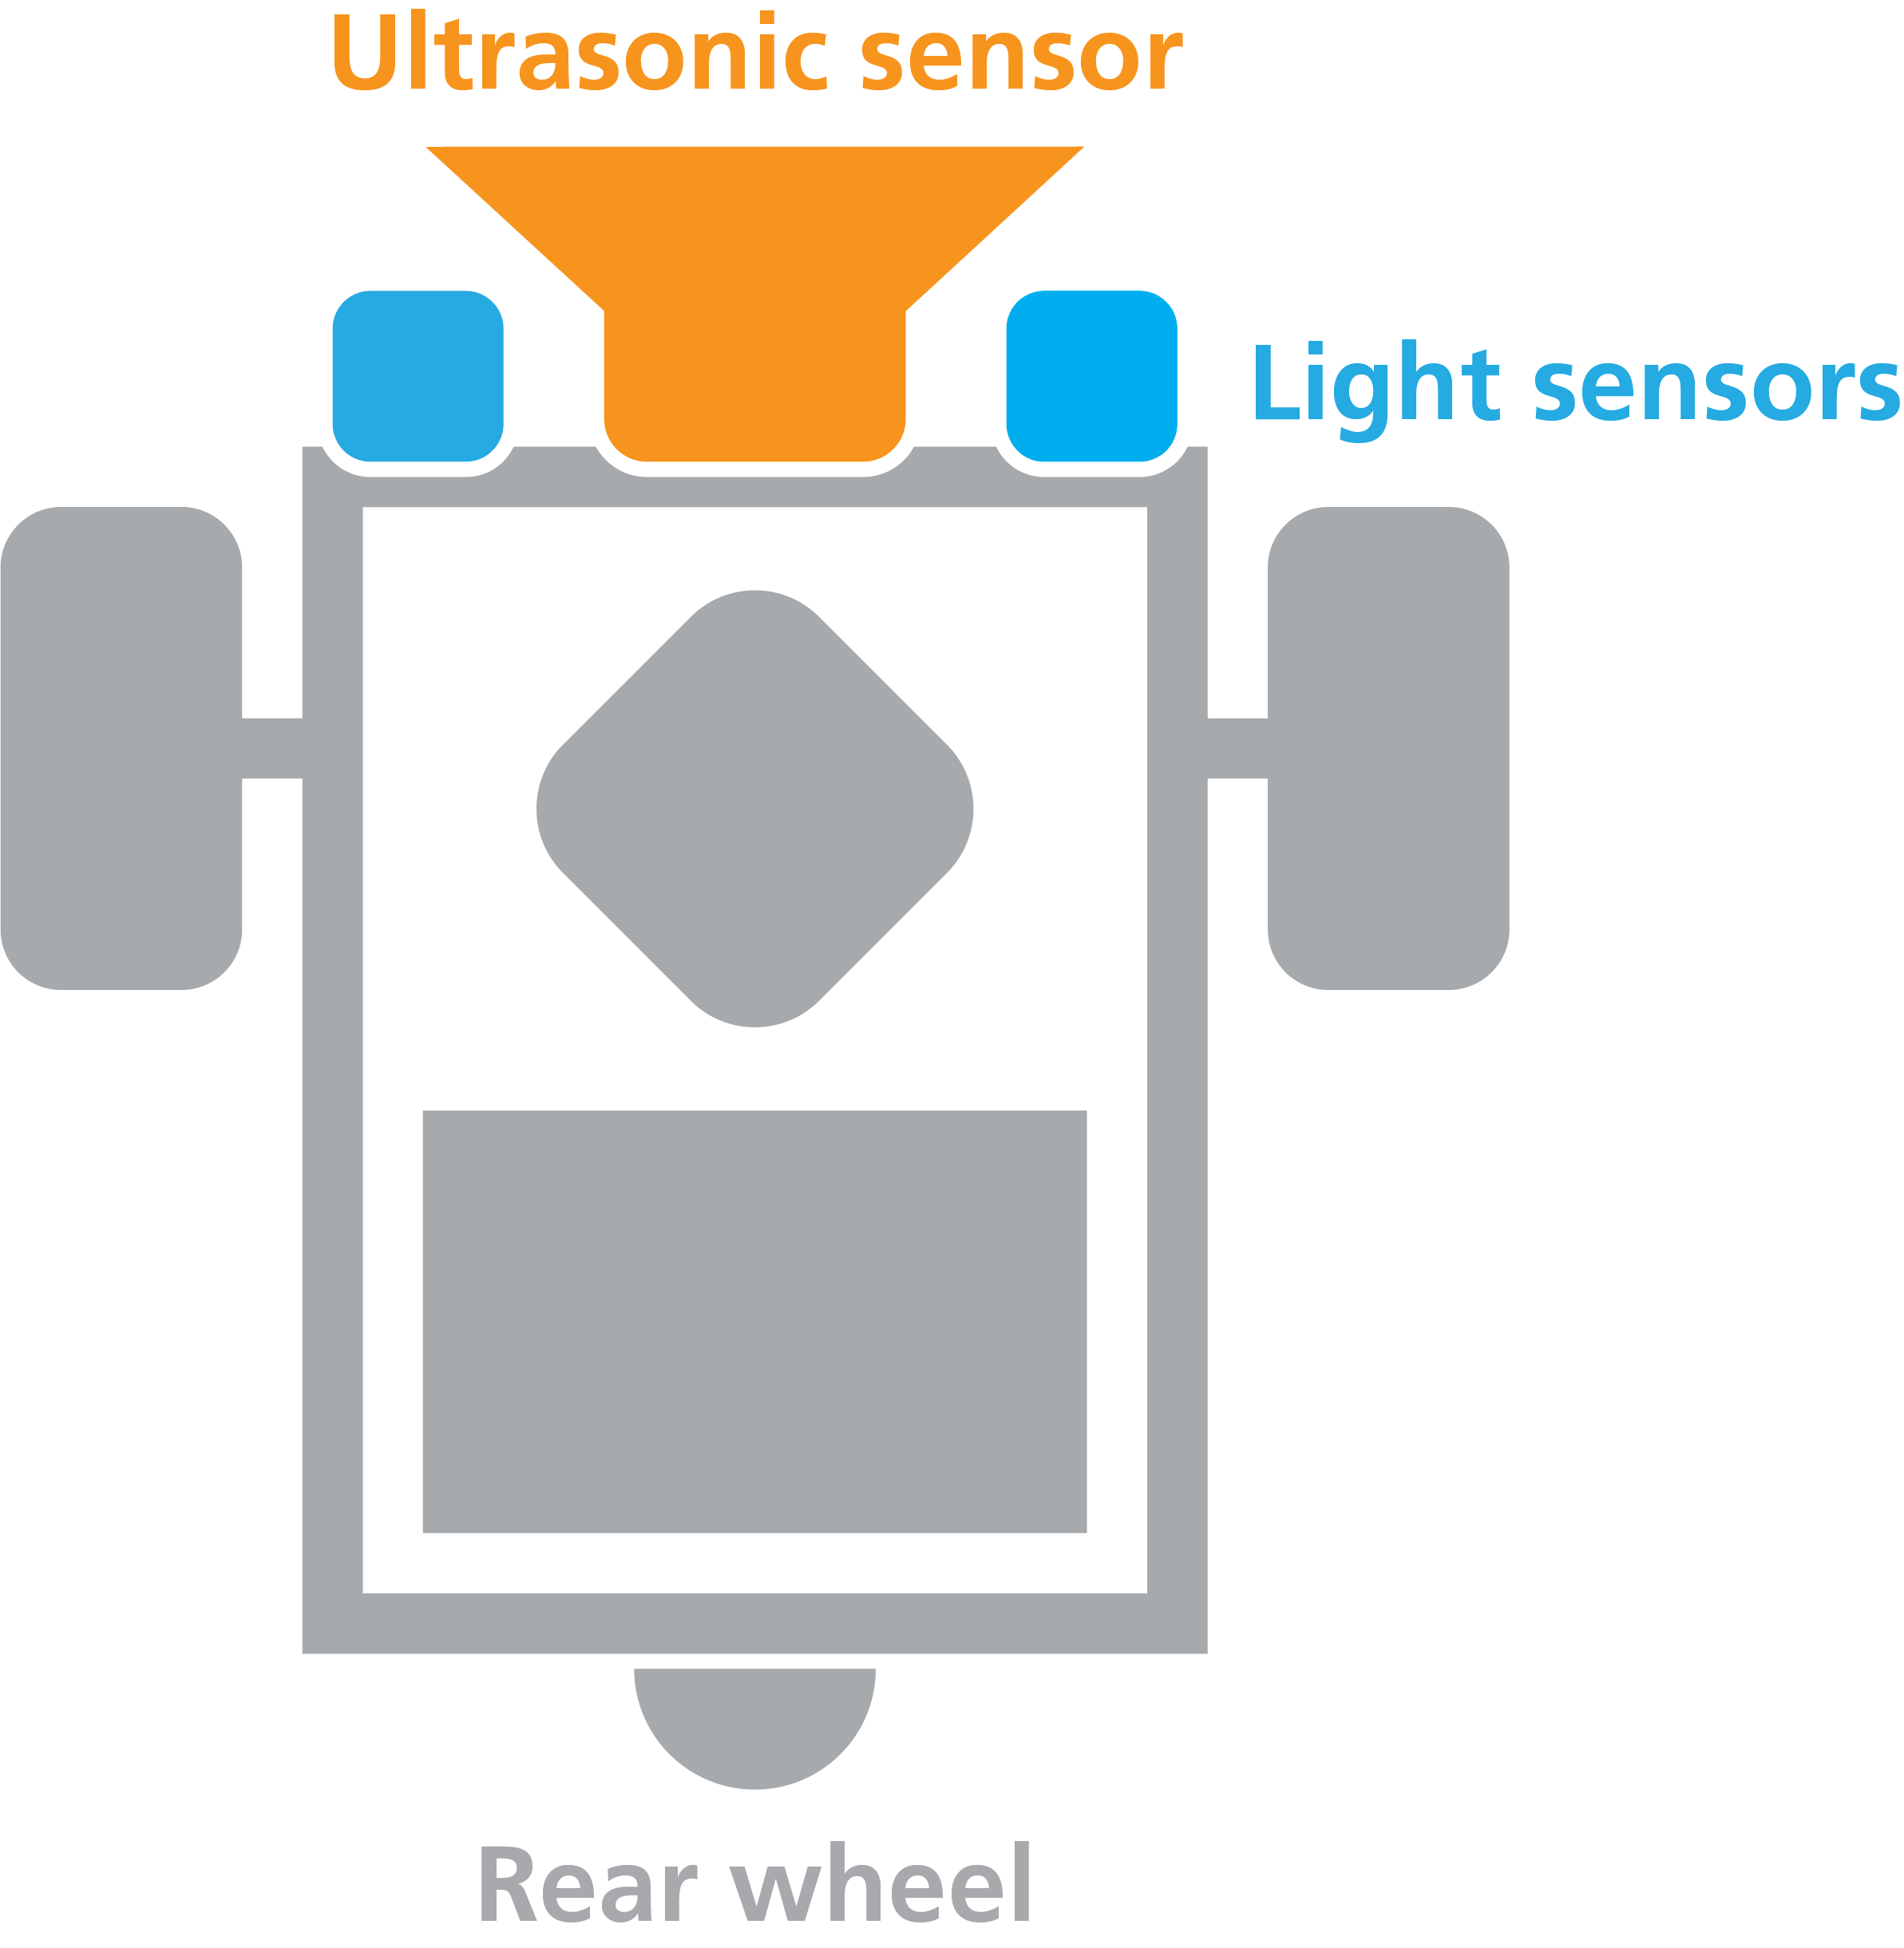
Note on Documentation
Capabilities document must be rewritten by new team (different members and skills)
Requirements and Constraints documents would largely apply to the new team but would need editing to reflect starting position
Current documentation could be partly reused by new group
Writing style and conventions
Graphics files
Notes:
ANDY → 1 minute (Can be extended or cut based on time)

Slide 16
Questions?

